Slide 1


Introduction to Two-Factor Authentication
In today's digital landscape, where data breaches and cyber threats are increasingly common, the need for robust security measures has never been more paramount. Two-factor authentication (2FA) is a powerful tool that adds an extra layer of security to your online accounts, protecting your sensitive information from unauthorized access.

Slide 2
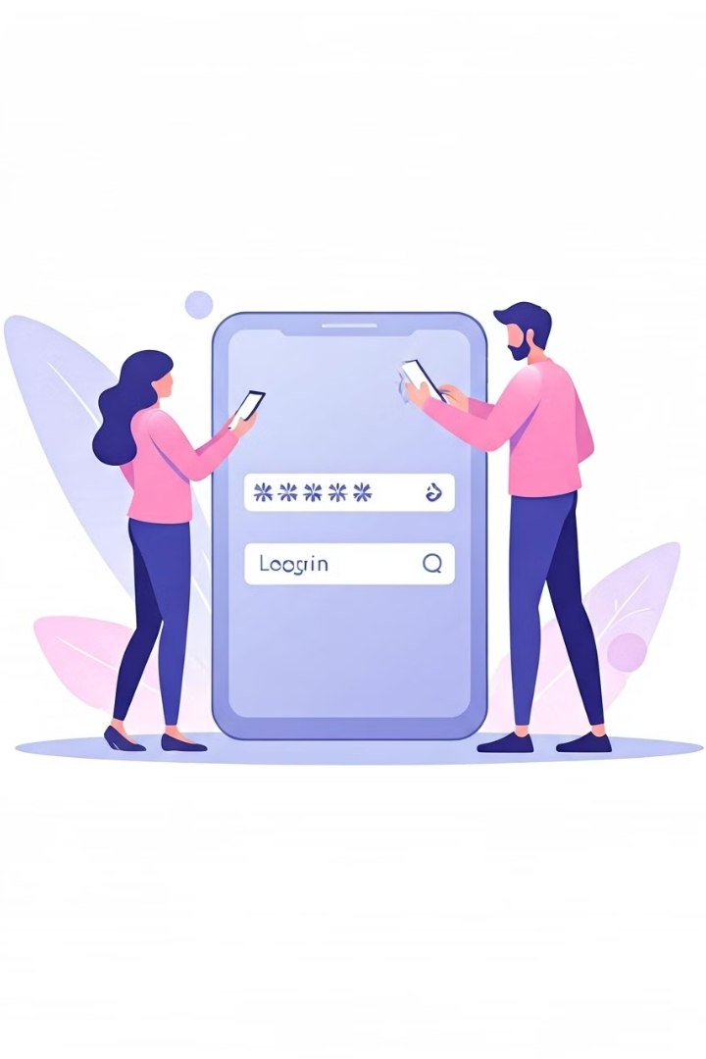
What is Two-Factor Authentication?
1
Two-Step Verification
Two-factor authentication is a security process that requires two distinct forms of identification to verify a user's identity before granting access to an account or system.
2
Something You Know, Something You Have
The two factors typically consist of something the user knows, such as a password or PIN, and something the user possesses, such as a smartphone or security token.
3
Enhanced Security
By combining these two factors, 2FA provides a much stronger level of security compared to relying solely on a password, making it significantly more difficult for unauthorized individuals to gain access to your accounts.

Slide 3

Why Use Two-Factor Authentication?
Protect Against Cyber Threats
Comply with Regulations
2FA helps safeguard your accounts from various cyber threats, such as phishing, password guessing, and data breaches, by adding an extra layer of security beyond a simple password.
Many industries and organizations are required to implement 2FA to comply with security regulations and standards, such as the Payment Card Industry Data Security Standard (PCI DSS) and the General Data Protection Regulation (GDPR).
Enhance User Trust
Reduce Financial Losses
By demonstrating a commitment to strong security through 2FA, organizations can build trust with their customers and users, who are increasingly concerned about the protection of their personal information.
2FA can help prevent unauthorized access to accounts, reducing the risk of financial losses due to fraud, theft, or other malicious activities.

Slide 4
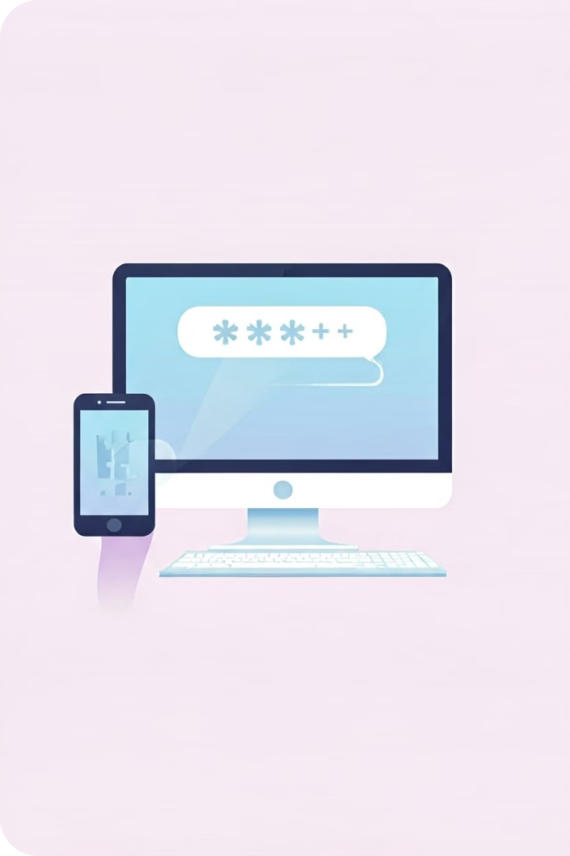
How Does Two-Factor Authentication Work?
1
Step 1: User Authenticates
The user attempts to log in to an account or system by entering their username and password, the first factor of authentication.
2
Step 2: Second Factor Requested
The system then prompts the user to provide a second form of authentication, such as a one-time code sent to their registered mobile device or a biometric factor like a fingerprint or facial recognition.
3
Step 3: Second Factor Verified
The user enters the one-time code or provides the biometric factor, and the system verifies the second factor to grant access to the account or system.

Slide 5
Types of Two-Factor Authentication
SMS or Voice Calls
Authenticator Apps
Security Tokens
One-time passcodes are sent to the user's registered mobile device via SMS or voice call, which the user must enter to complete the authentication process.
Users install a dedicated authentication app on their smartphone, which generates one-time passcodes that must be entered to verify the user's identity.
Hardware security tokens, such as USB keys or smart cards, generate one-time passcodes or provide a physical method of verifying the user's identity.

Slide 6





Implementing Two-Factor Authentication
Identify Sensitive Assets
Determine which accounts, systems, or data require the additional security provided by 2FA.
Choose 2FA Method
Select the most appropriate 2FA method based on your organization's needs, user preferences, and technical capabilities.
Integrate 2FA Solution
Implement the chosen 2FA solution, ensuring seamless integration with your existing systems and processes.
Train Users
Educate and train users on the importance of 2FA and how to properly use the selected authentication method.

Slide 7





Best Practices for Two-Factor Authentication
Secure Accounts
Ensure that all accounts with sensitive information or critical functions are protected by 2FA.
Use Dedicated Devices
Encourage users to use a dedicated smartphone or device for 2FA, rather than a shared or public device.
Layer Security
Combine 2FA with other security measures, such as strong passwords, to create a robust multi-layered defense.
Regularly Update
Regularly review and update your 2FA policies and procedures to address evolving security threats.

Slide 8
Advantages of Two-Factor Authentication
Improved Security
Enhanced User Experience
Regulatory Compliance
2FA significantly reduces the risk of unauthorized access by requiring two distinct forms of verification, making it much more difficult for attackers to compromise user accounts.
With the increasing adoption of 2FA, users are becoming more familiar and comfortable with the additional security steps, leading to a more seamless user experience.
Implementing 2FA helps organizations comply with various industry regulations and standards, such as PCI DSS and GDPR, which often mandate the use of strong authentication methods.

Slide 9

Limitations and Challenges of Two-Factor Authentication
1
User Inconvenience
Some users may find the additional steps required for 2FA to be inconvenient, especially if they need to authenticate frequently or on multiple devices.
2
Dependency on Devices
2FA relies on the user having access to a secondary device, such as a smartphone or security token, which can be lost, stolen, or malfunctioning, potentially locking users out of their accounts.
3
Vulnerability to Attacks
While 2FA provides stronger security, it is not immune to certain types of attacks, such as SIM swapping or man-in-the-middle attacks, that can compromise the second factor of authentication.

Slide 10
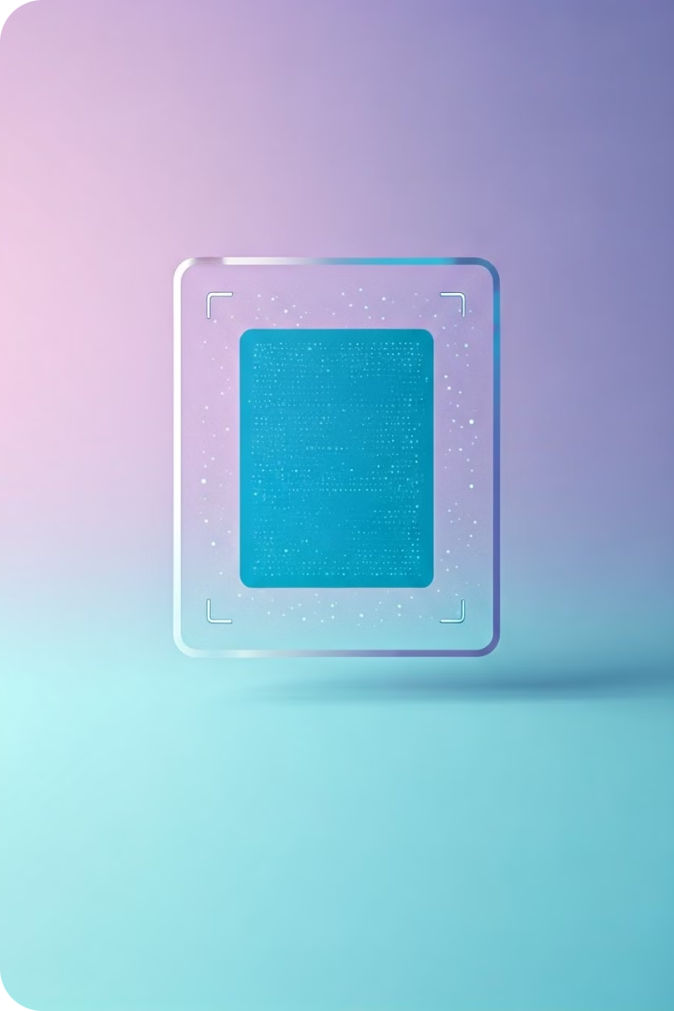
The Future of Two-Factor Authentication
1
Biometric Authentication
Advancements in biometric technologies, such as fingerprint, facial, and iris recognition, are expected to play a more prominent role in 2FA, providing a more seamless and convenient user experience.
2
Blockchain-Based Verification
The integration of blockchain technology into 2FA solutions can enhance security and decentralize the authentication process, reducing the reliance on centralized systems and third-party providers.
3
Adaptive Authentication
Intelligent systems that can dynamically adjust the authentication requirements based on user behavior, device location, and other contextual factors are likely to become more prevalent, providing a more tailored and secure user experience.

